Slide 1
Real-Time Analytics in Ecommerce Transaction
Presented by,
NIYAZ AHMED

Slide 2
Objective
To analyze the data of the E-Commerce Transaction and Customer Details so that the E-Commerce Company can Analyze them and apply business methodology so that it helps them in future growth in terms of Sales, Customer Satisfaction and many more.

Slide 3


1) Constraint Based Amount Scenario
Based upon the amount a user spend while purchasing a product.
Transaction where amount is between a range
Transaction where amount is greater then a price point.

Slide 4


2) Top Spenders in the store
Shopping festival usually occurs on Flipkart called as Big Billion Day Sale
The top spenders in the Sale are always given a gift hamper or some other offers
Total sale of each customer for a particular period is calculated.

Slide 5

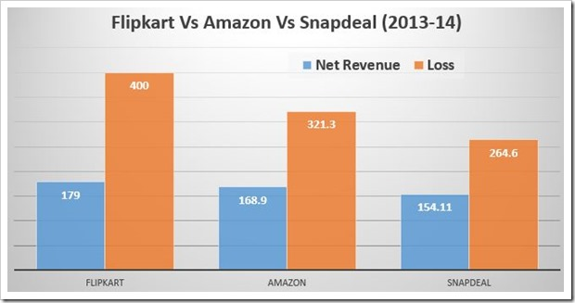
3) Revenue made via transaction
Ecommerce data is composed of transaction and item data.
Every Transaction has a record log from where they can calculate their revenue made in a particular month or a complete year.
It helps to understand their company position and status.

Slide 6

4) Customer Dilemma
Customer Care related problem
If a person buys a good or service from the Flipkart, and suppose in future there is some problem with that then the customer can call up the customer care people to address his problems
The records for purchases are stored in log, so only customer Id is needed and all information can be fetched.

Slide 7

5) Product Promotion and Customer Targeting
We can calculated their total sum of money they spent on a particular E-Commerce site, their average transaction and number of visits.
Depending upon their shopping behavioural pattern we can analyze them

Slide 8
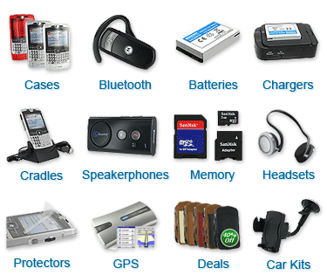

6) Product Category Specification
E-Commerce Company normally sell their product based on category.
Find the number of products in each Category.

